Slide 1
PROJECT: Manhunt Code Eagles
Ahmed Al-ali Majed Al Mazrouei Naser alkhateri

Slide 2
Game Rules:
2 Players (PVP & PVC)
2-Dimensional Board (5 x 5 to 20 x 20 spaces)
Each turn has 3 moves
Enemies not visible to each other
Each player has a radar
Threat is measure in blocks making up a horizontal bar.
First player to land on the other wins.

Slide 3

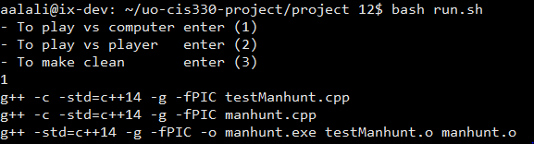



How To Run and Play?
In the project directory, type in “bash run.sh” in the bash command line.

Slide 4
How To Run and Play?
A prompt will ask for a user choice, as the following:

Slide 5
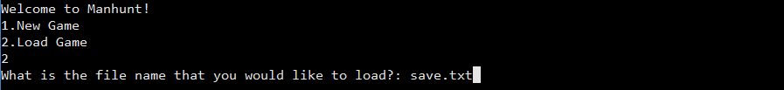
How To Run and Play?
The choice will create the required executable file and run it. Another prompt will ask user if it is a new game or a loaded game.
In the case the user wanted to load game, the user will be asked to input save file name.

Slide 6
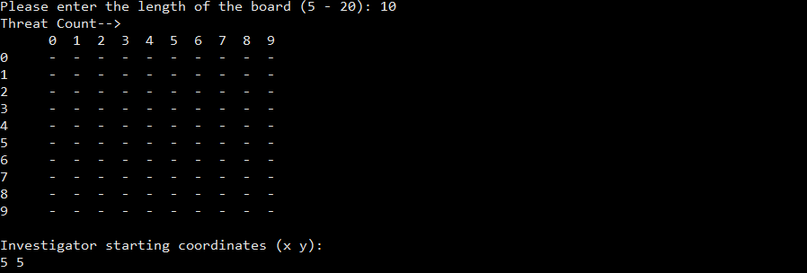
How To Run and Play?
In the case of a new game, the user will be prompted for a board size and spawn point. A bot’s spawn is randomized:

Slide 7
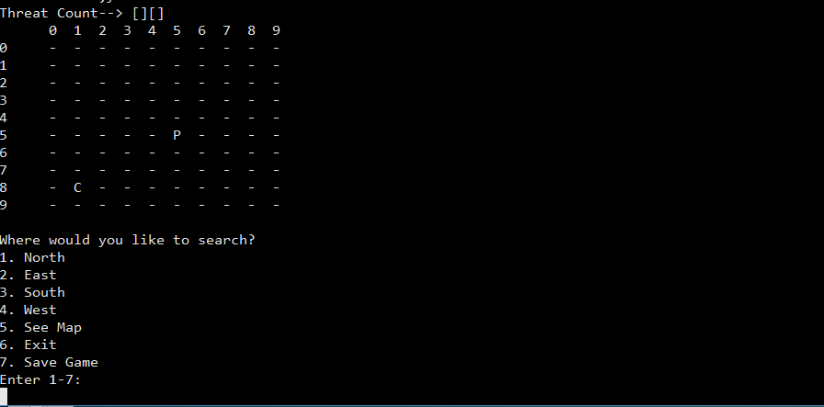
How To Run and Play?
The Player then sees the board with the current position marked as ‘P’. (For explanation purposes, opponent (bot) is marked as ‘C’):

Slide 8
How To Run and Play?
Threat count basically announces the possible perimeter of the opponent. As it increases, the perimeter decreases.
Threat Count []
Threat Count [][]
Threat Count [][][]
Threat Count [][][][]
Threat Count [][][][][]

Slide 9
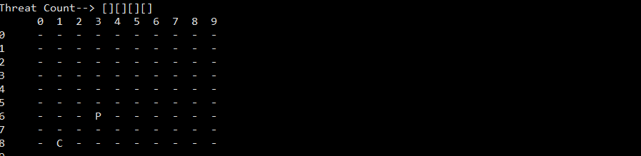
How To Run and Play?
After a 2 moves west and 1 move south (3 total), the threat count updated:

Slide 10
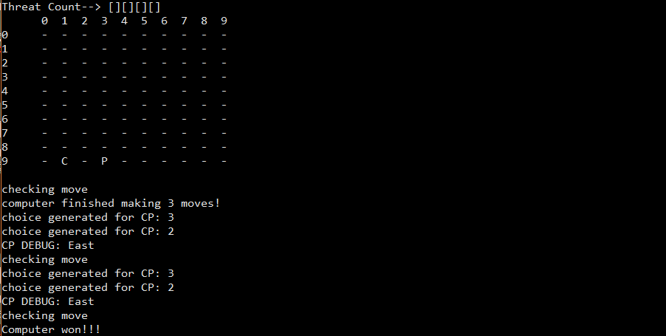
How To Run and Play?
After completing the player’s moves, the computer moved two spaces East, and caught the player by landing on the same coordinate. Thus, the bot wins!

Slide 11
Demo!

Slide 12
Possible Future Development
An online multiplayer game in which each grid is fixed, and the number of players are limited.
Free For All
The three turns are limited/paused with a 30 second stun.
Bird’s-eye-view of a 3 dimensional graphical grid.
Last man standing wins!

Slide 13
Thank You. Fin.

